Slide 1

NATIONAL INSTITUTE FOR LEGISLATIVE STUDIES
NATIONAL ASSEMBLY
FINANCE AND DOCUMENTATION: NILS AND DEVELOPMENT PARTNERS AT THE NILS INTERACTIVE WORKSHOP FOR NILS &
NILS-CAP STAFF AT THE SENATE WING NASS FROM 19-21 JAN. 2014

Slide 2
PREAMBLE:
The place of Finance in NILS and any organization for that matter need not to be over-emphasized. However, for the purpose of this meeting and the benefit of our new colleagues in NILS, I will start by giving a brief definition and functions of Finance to refresh our minds and memories.
We shall also look at an unbridged Guidelines and Procedures in NILS for effective preparation of program Budgets, Disbursement and payment to Consultants. In the course of the presentation, we shall also rub minds together on issues bordering on Staff Salary, Allowances, Pension Fund and advances.

Slide 3
WHAT IS FINANCIAL MANAGEMENT?
Financial Management means the efficient and effective management of funds in such a manner as to accomplish the objectives of the organization.(Source: Wikipedia)
It is the planning, directing, organizing, monitoring and controlling of the financial resources of an organization
Financial Management system as a tool assist the project directors in ensuring the overall objective of the project are achieved.
By enabling us to track the utilization of each pool of funds, the balance of funds available to complete the project and the expenditure incurred to date for each cost category of the project
It helps us to comply with covenants attached to the funds

Slide 4
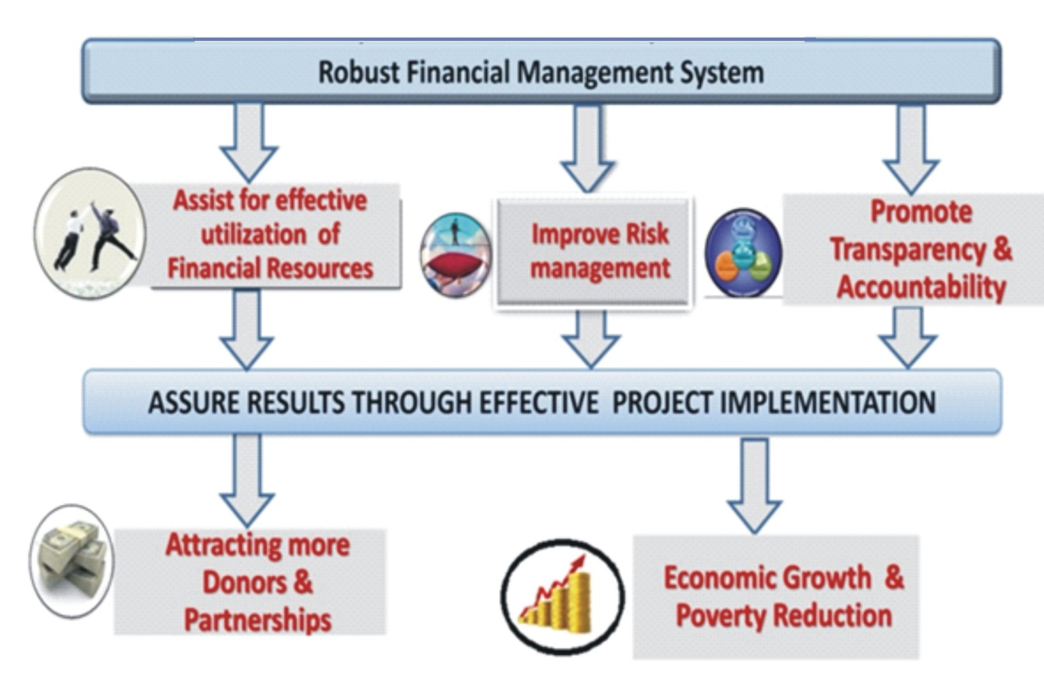

Slide 5











WHAT ARE THE KEY PILLARS
OF FINANCIAL MANAGEMENT?
Accounting
System
Procurement
Planning &
Budgeting
Financial
Management
Control &
Financial
Audit
Reports

Slide 6
I. Accounting system and records
A good accounting system can:
Produce information that meets the needs of key stakeholders
Provide complete, timely, reliably and consistent information for decision makers and public
  An Ideal Accounting system
  Accurately capture transactions
  Establish adequate controls
  Reconciliations
  Segregation of duties
  Policies and procedures

Slide 7
Minimum requirements for good system:
Proper Books of Accounts preferably computerized application Up to date Accounting Manuals
-regularly reviewed
Adequate Segregation of duties
Involve regular review and approval-check and balance
Safeguard assets, documents/records and backups

Slide 8
Poor accounting system generates:
Incomplete and inaccurate accounting information
Does not serve the purpose
Ineligible transactions not chargeable to the Budget
Duplication of expenses or (double dipping )
Loss or misplacement of vital accounting information or document
Incomplete supporting or source documents (Delay in financial reporting)
Does not facilitate timely decisions

Slide 9
III. FINANCIAL REPORTING
Types of Financial Reports :
Annual Financial Report
Prepared on the basis of recognized standards such as IFRS,
IPSAS, GAAP or local standards
Management Reports (Periodical)
Monthly Bank Reconciliation Reports
Budget/Workplan Implementation Reports (Variance analysis)
(Interim Financial Report IFR )

Slide 10
Qualitative Characteristics of Financial Statements
  Understandability - prepared in clear manner
  Relevance - timely influence of the
  economic decisions of users
  Reliability - faithful representation of
  financial situation
  Comparability -Ability to compare timeline
  activities and across sectors
Finance Activities that affects Staff
Procurement & Documentation
Procurement of Goods
Procurement of Services
Procurement of Consultancy

Slide 11
PROCEDURES
Requisition from the User Dept.
Report from Stores that these goods are not available (O/S)
Memo to Approving Officer through Unit Heads
Invitation of Suppliers for quotation and advertisement
Analysis of quotation and selection report
Issuance of Award Letter to successful vendor
Drafting of legal Agreement
Execution of Contract
Documentation for payment
Appropriate Store Receipt Procedures for Goods
Completion Report for services and consultancy
Request for payment by vendor

Slide 12
ADVANCES
Section 1701 - 1710 of the Financial Regulation clearly defined and outlined Advances and the categories of advances. They include:
Personal (Staff Salary) Advance
Non-personal Advances
  Purchase Advance
  Touring advance
    International
    Local
Documents Required
Visa Page
Passport Data Page
Admission Letter
Invoice
Competitive Travel Agent Invoice
Approval

Slide 13
RETIREMENT OF ADVANCES
Advances taken are subject to full retirement upon the execution of the transaction.
Retirement is the process of rendering return (Accounting) of funds received as stated above (Advances). This is an evidence that the purpose for which the advance was made is justified by means of :-
  Official Receipt
  Invoices
  Acknowledgement
  Boarding Passes
  Stamped Official Visa Page
  Reports

Slide 14
PENALTY FOR NON RETIREMENT OF ADVANCES
Non retirement of Advances is a serious breach of Financial Regulation and the
Institutes Financial guidelines and Regulations. Sanctions such as verbal warning, Written Warning and Withholding of Salaries are but a few sanctions that the Institute applies to defaulters.

Slide 15
GUIDELINES AND PROCEDURES
FOR PREPARATION OF PROGRAM BUDGETS/DISBURSEMENT AND THE PAYMENT TO CONSULTANTS

Slide 16
Following the extensive deliberations at the Management Retreat of 15th August 2014 on the Standing Guideline and Procedures for the payment of Consultants, Media, Contingency and Staff Claims for Programs Local and International, Please find as summarized below the Standing Rules and Applicable Rates for your guidance:-
CONSULTANTS:
The rate payable to Consultants on daily rate contract is as follows:-
Category A - Senior Consultants - $400/day
Category B - Middle Cadre Consultants - $300/day
Category C - Junior Consultants - $250/day
All Consultants must sign Consultancy Agreement with the Institute before commencement of work.

Slide 17
RESOURCE PERSONS:
Resource Persons are to be paid for full day presentation and not per paper as follows:-.
Senior Resource Persons - N150,000/Day
Junior Resource Persons - N100,000/Day
Statesmen and other Public figures Subject to Management Decision.
MEDIA:
Media payment for programs - N100,000.00
Media Payment major programs/events - Subject to Management Decision

Slide 18
CATERING SERVICES:
In-House Caterers
Lunch - N1,500
Tea/Break - N 800
Outside Caterers:
Lunch - N2,000
Tea/Break - N1,000
Specialized Catering Services can be arranged for programs involving Legislators and Senior Participants and the applicable rate will be decided and agreed upon by Management.
SECRETARIAT
Stationeries
Stationeries are to be procured as categorized below:
Under 50 Participants - 5 Cartons of Paper
51-75 Participants - 10 Cartons of Paper
76-100 Participants - 15 Cartons of Paper
Above 100 Participants-20 Cartons

Slide 19
Banners
Every program shall have not more than 2 Banners.
Rapporteurs
Rapporteurs Allowance for Programs shall not be more than N100,000.00, but for major Programs the amount could be determined by Management depending on the magnitude.
CONTINGENCY:
Contingency is categorized as follows:
Contingency for Local Program Abuja based - N100,000
Contingency for Local Program Outside Abuja - N200,000
Local Running to Participants outside Abuja - N10,000/Trip
Note also that Contingency payment to Participants for International Programs shall be as follows:-
Training Programs - Nil
Official Assignments and Exchange of Experience Visits - Applicable as in Admin. Manual

Slide 20
NOTE:
All other applicable rates for DTA and Estacode are as stipulated in the Administrative Manual of the Institute in conjunction with the Public Service Rules (PSR).
Program/Activity Budgets are to be drawn in conjunction with the Budget Unit of the Accounts Division in order to ensure consistency with the Guidelines.
Disbursement of Program Expenses shall be done by a designated Account Staff only.

Slide 21
END OF PRESENTATION
Q&A

